Slide 1

Surface Tension and Viscosity Measurements
by the Oscillating Drop Method on Board
Parabolic Flights
R. K. Wunderlich¹, K. Higuchi², S. Schneider³,
M. Engelhardt³ and H.-J. Fecht^{1,4}
¹ University of Ulm, Institute for Micro and Nanomaterials, Ulm, Germany
² Japan Aerospcace Exploration Agency, Institute of Space and
Astronautical Science, Kanagawa, Japan
³ DLR-Cologne, Institut für Materialwissenschaft im Weltraum, Germany
⁴ Research Center Karlsruhe, Institute for Nanotechnology, Karlsruhe,
Germany
Workshop ESTEC 2006
The Funding of Microgravity Applications Projects (MAPs) towards industrial needs
Noordwijk, March 14-15, 2006

Slide 2
Outline
processing in eml for surface tension and
and viscosity measurements
progress in data recording and analysis
some results
- results of a PdSi calibration experiment

Slide 3
Samples of Interest:
Ti- alloys T_{liq} ≈ 1700 °C
NiAl alloys T_{liq} ≈ 1330 °C
Fe- alloys T_{liq} ≈ 1500 °C
Mg, Li - alloys T_{liq} ≈ 1200 °C
Microgravity Platforms:
Parabolic flights 20 sec. of μ-g time
TEXUS sounding rockets 300 sec. of μ-g time
ISS long duration μ-g

Slide 4
Problem:
- high temperature – high chemical reactivity
reaction of sample with container
wrong and unreliable property values
Approach:
containerless processing in an
electromagnetic levitation device
- use of microgravity conditions

Slide 5
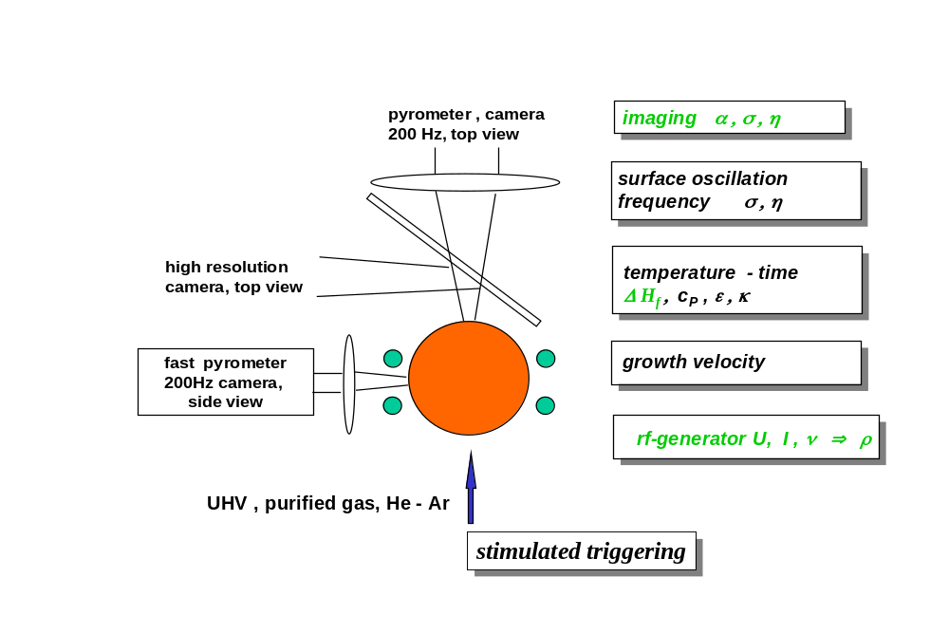
Analytical Capabilities of the TEMPUS
Electromagnetic Levitation Device

Slide 6
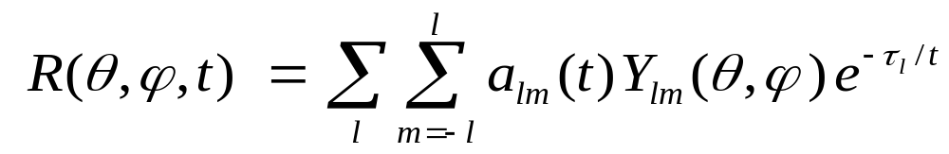
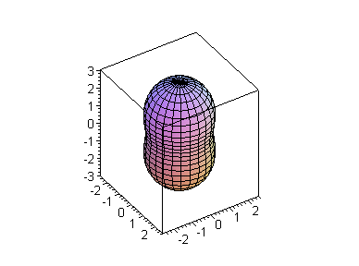
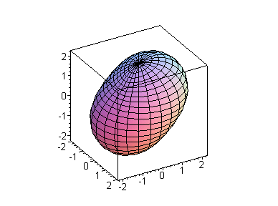
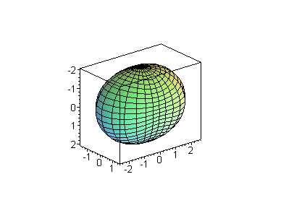
Surface Tension: Oscillations of a Liquid Sphere
The Y_{2m}-modes are relevant for practical surface tension
and viscosity measurements; m = 0, ±1, ±2
Y₂₀
Y₂₁
Y₂₂

Slide 7
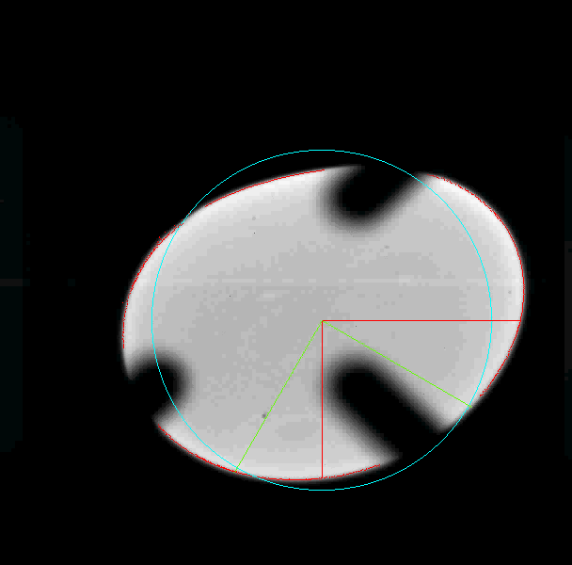
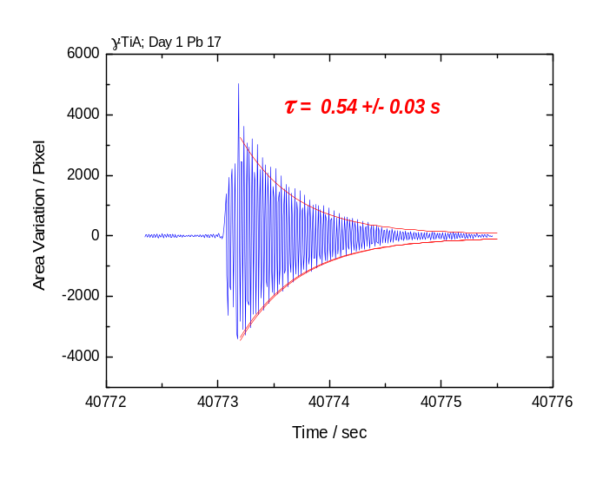
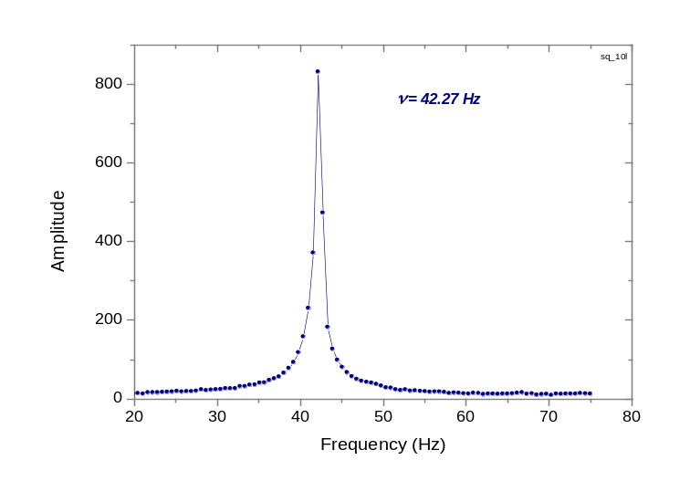
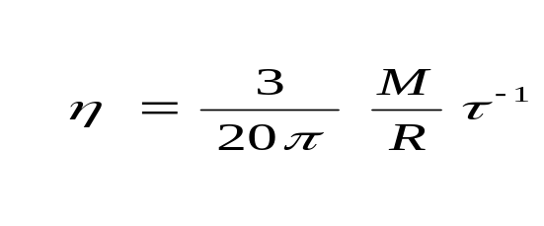
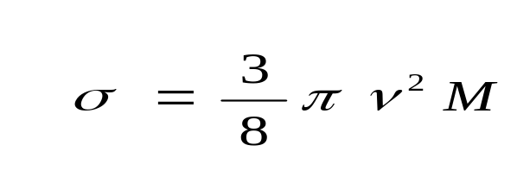
Analysis of Sample Shape Deformation
Recording of sample shape deformation with 200 Hz digital cameras
Viscosity from damping time constant
Surface tension from frequency

Slide 8
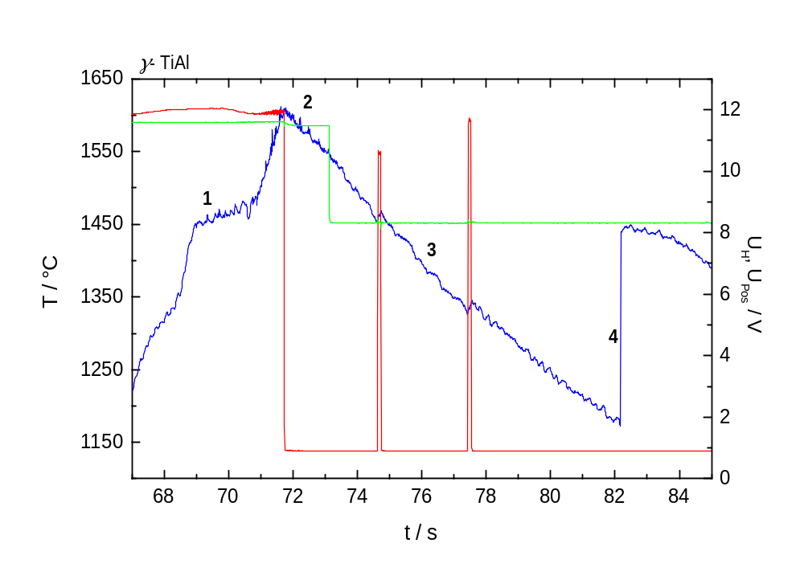
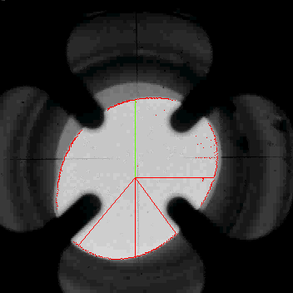
Examples of parabolic flight processing with 20 sec
of reduced gravity
γ –TiAl T_{liq} = 1844 K
γ -TiAl top view
temperature – time profile

Slide 9
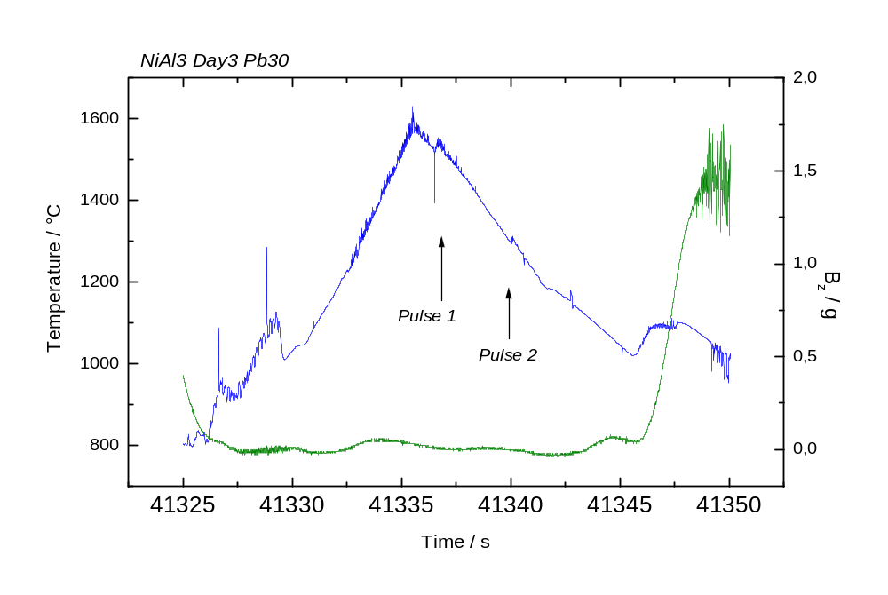
Ni-68.5at%Al: T_{sol} = 1100 K, T_{liq} = 1620 K
temperature – time profile

Slide 10
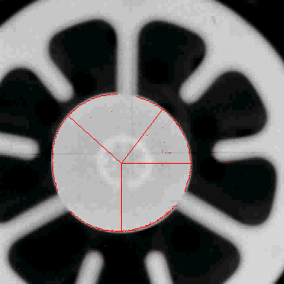
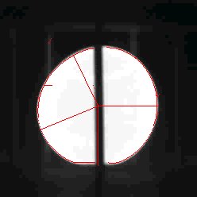
Progress in data recording and analysis
axial
Recording:
200 Hz digital cameras in
axial and radial position
Analysis:
Shape detection algorithm.
Contour fit with polynomial in cosϕ
Sum & difference of two radii.
Sum & difference of two rotated radii
Rotating radii with selected frequency
Total area
Difference area to projected sphere
radial

Slide 11
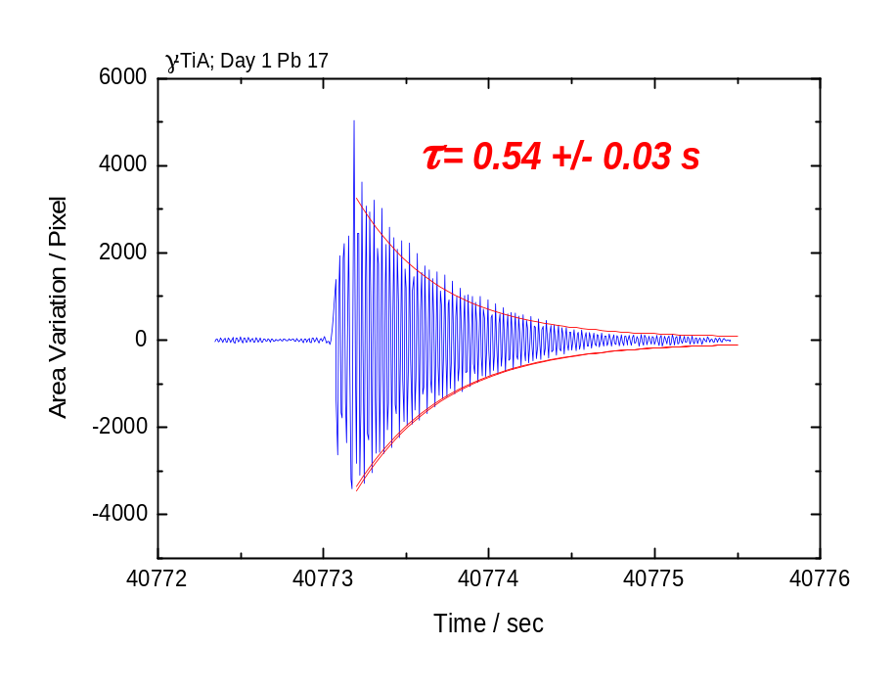
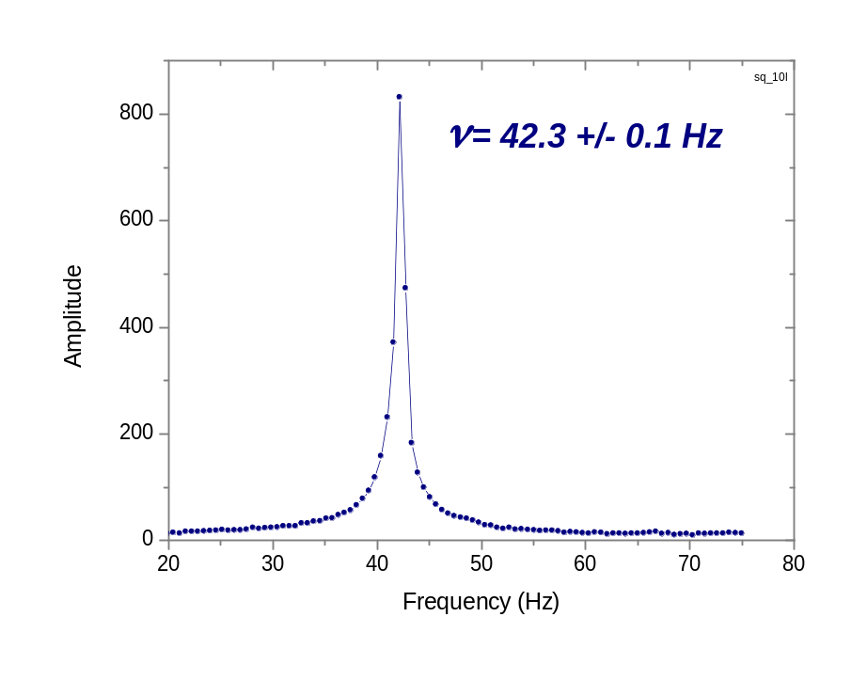
Examples of data quality
Variation of the projected sample area, top view. 200 Hz digital recording. Y₂₀ oscillation mode.
Fourier transform of a 1.24 second time slice.

Slide 12
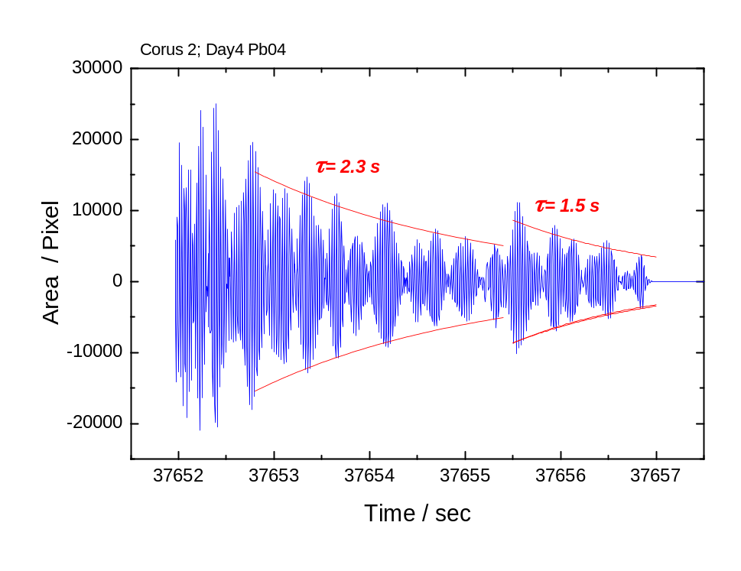
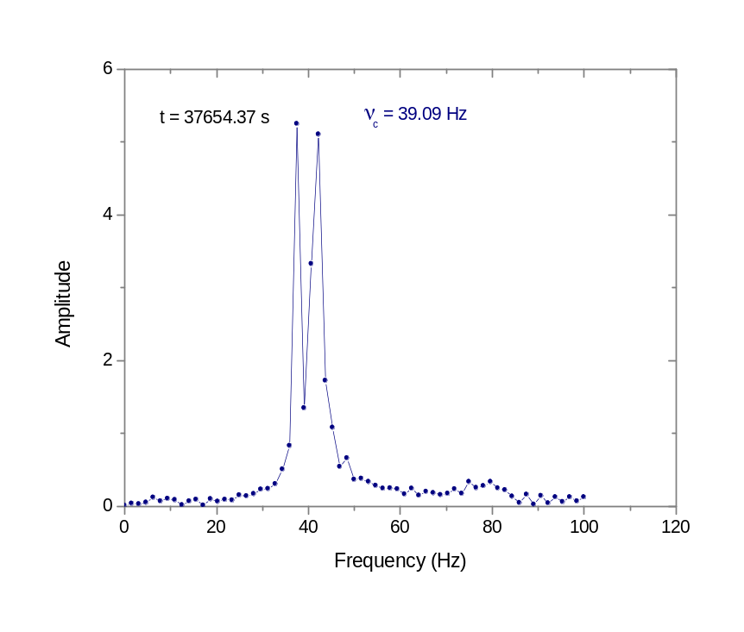
Examples of data quality ctd.
Sample rotation & precession results in modulated decay
decay of measured surface deformation
Surface oscillation frequency can be determined with good
accuracy, 3%, but reduced accuracy for decay time constant.

Slide 13
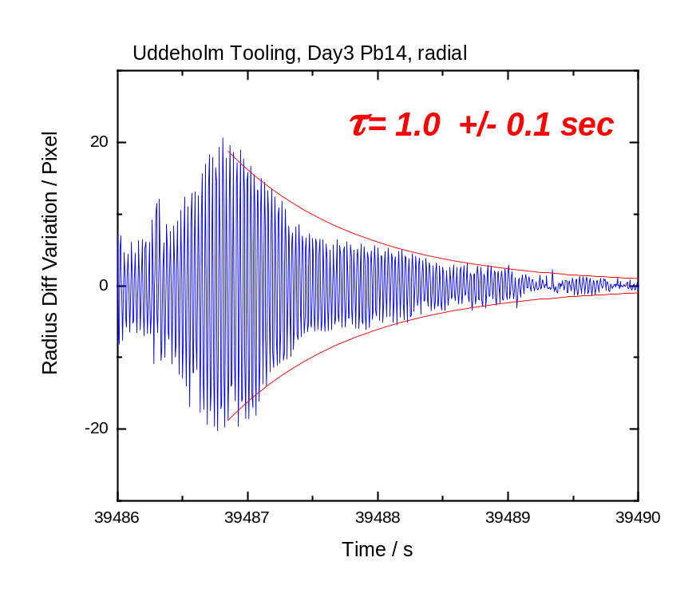
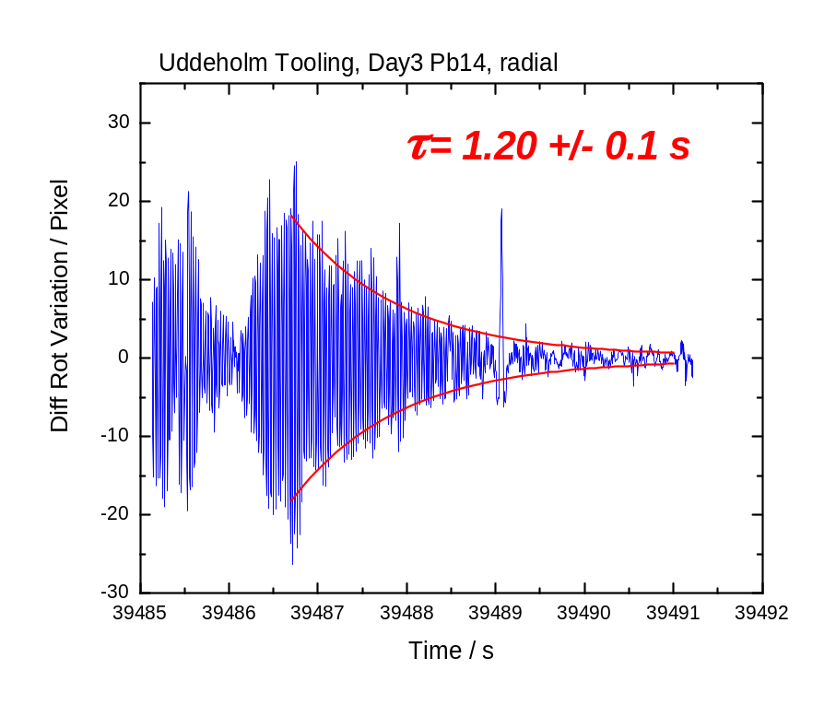
Different measures of sample shape deformation
x,y radius difference of radial view - sensitive to Y₂₁
Rotating coordinate frame gives an improvement
in decay time determination.

Slide 14
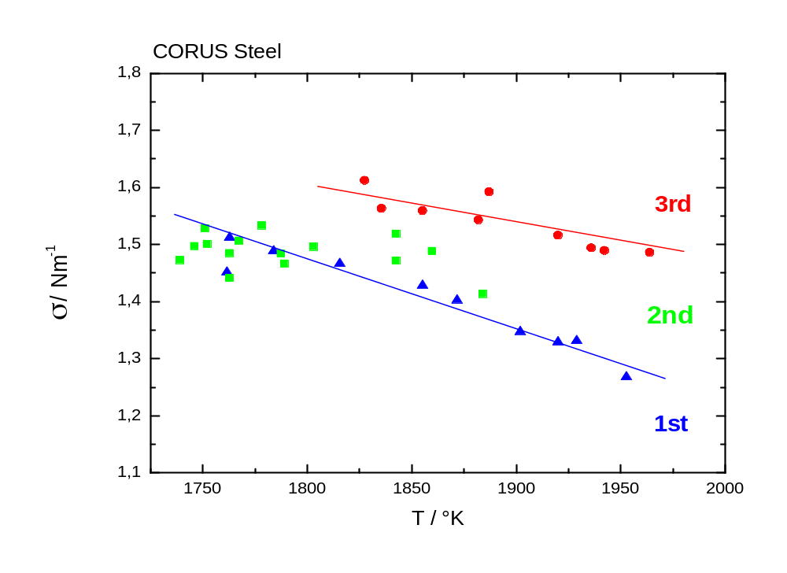
Examples of results: CORUS Steel
Surface tension as a function of temperature
Composition before processing:
Si: 1.05at%, S: 0.10 at%,
Mn: 0.90at%, Fe: 97.94at%
Composition after processing:
Si: 0.43at%, S: 0.01 at%,
Mn: 0.20at%, Fe: 98.80at%
Pb26: σ(T) = (1.53 ± 0.03) – ( 1.2 ± 0.35 ) 10⁻³ ( T − 1752 K ) Nm⁻¹
Pb29: σ(T) = (1.63 ± 0.03) – ( 8.3 ± 0.35 ) 10⁻⁴ ( T − 1752 K ) Nm⁻¹

Slide 15
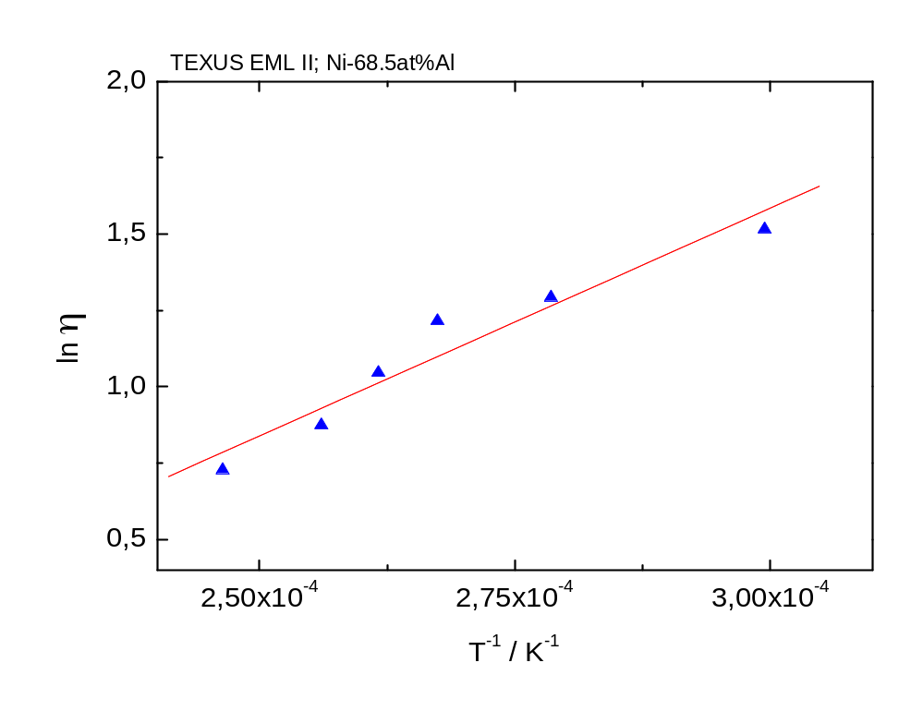
Viscosity of Raney-NiAl as a function of temperature
η = η_{o} exp ( ΔE_{a} / k_{B} T )
ΔE_{a} | 0.55 eV/atom
η_{o} | 0.056 mPa.s
TEXUS: η (1670 K) = 4.56 ± 0.24 mPa.s
PF: η (1670 K) = 4.24 ± 0.22 mPa.s
good agreement with oscillating cup measurment at NPL

Slide 16
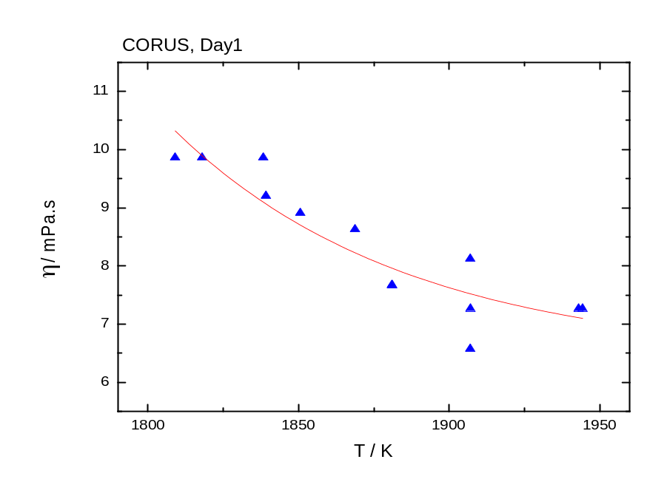
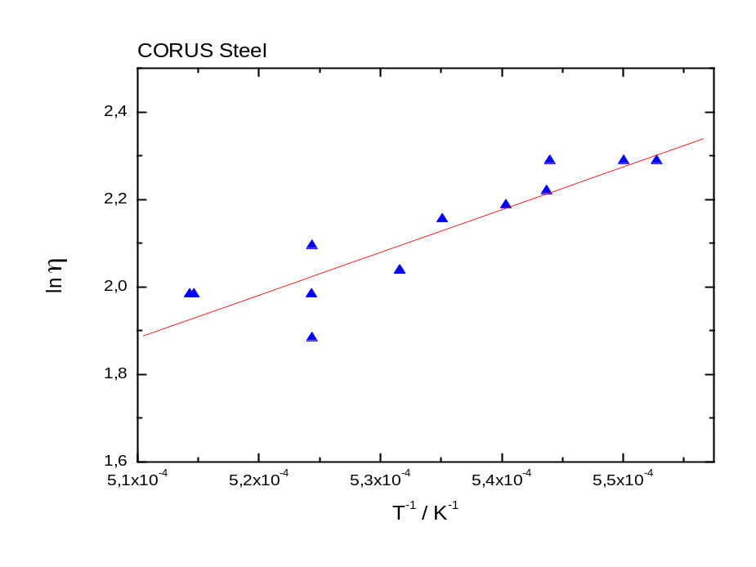
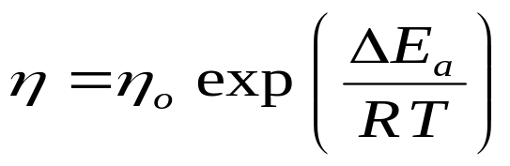
Viscosity CORUS Fe-Alloy
(T_{liq}) = 11.3 mPa.s
too high !
ΔE_{a} | 0.725 eV/atom
η_{o} | 0.042 mPa.s
Viscosity:

Slide 17
Calibration Experiment with Pd-18at%Si
Accurate viscosity measurements require the absence of turbulence:
investigate effect of initial oscillation amplitude on the viscosity
investigate the effect of a residual heating field on the viscosity
Accurate viscosity measurements require the absence of
em-interactions between sample surface oscillations and the
positioning and heating fields:
- investigate the effect of the positioning field on the viscosity

Slide 18
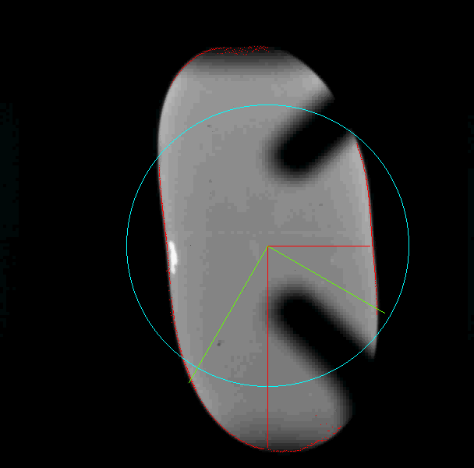
Initial sample shape deformation
initial sample deformation
heating in a short time
decay time of initial turbulence
best to apply surface excitation
pulse to a spherical specimen
- time limitation in PF
initial deformation ≈ 28 %, initial velocity v = Δd·ω ≈ 3.5 cm s⁻¹
Re ≈ 120

Slide 19
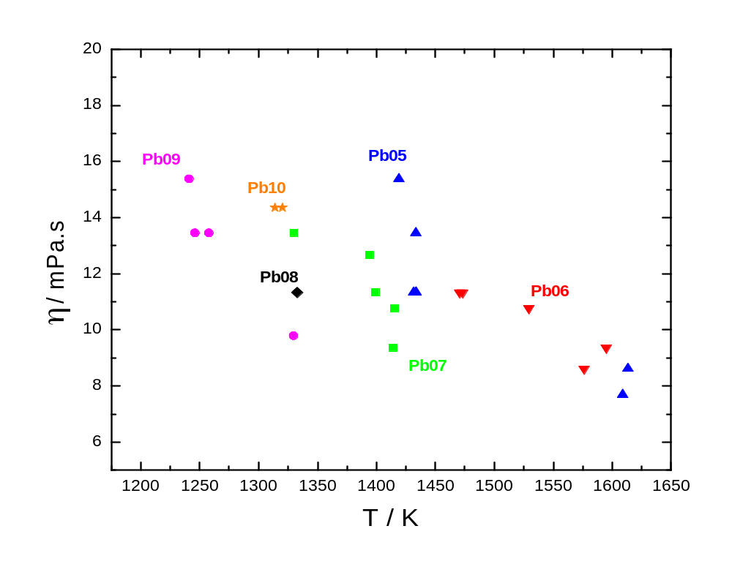
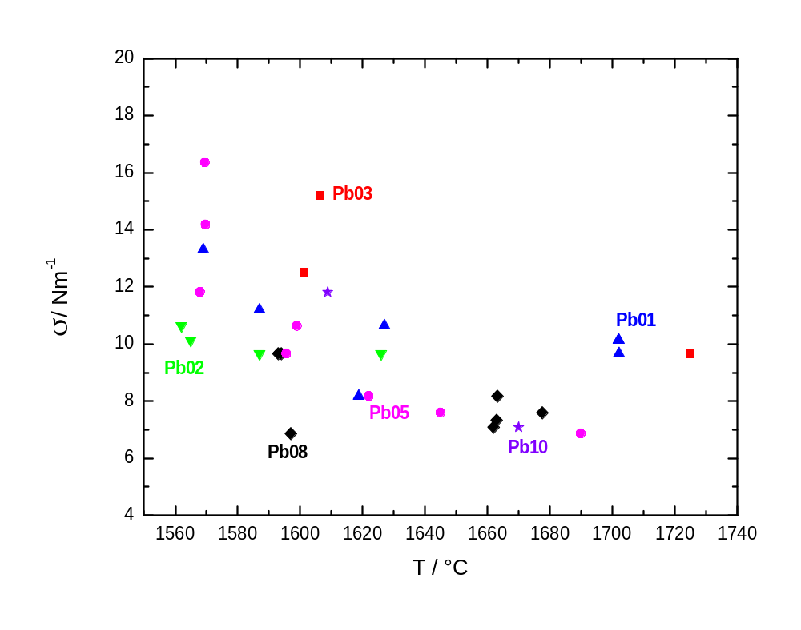
Viscosity of Pd-18at%Si with a variation of positioner field,
excitation amplitude and residual heating field variation.
σ(T) = (1.56 ± 0.03) – ( 5.95 ± 0.35 ) 10⁻⁴ ( T − 1229 K ) Nm⁻¹
η(T_{liq}) = 15.9 mPa.s
MSL-1 spacelab Pd₇₈Cu₆Si₁₆ η(1250K ) = 18 mPa.s

Slide 20
Results: Effect of processing parameters on
surface oscillation dmping time constant
Positioner field: within exp. accuracy ≈ 10%
Excitation amplitude: increase by 30%
Residual heater field: none for 0.5 V control voltage
Time delay heater off / pulse: to be done

Slide 21
Current issues of parabolic flight processing
for surface tension and viscosity measurements
Sample rotations complicate the analysis of the surface oscillation damping time constant:
Different measures of sample shape deformation, rotating
coordinate system, synchronized radial and axial cameras, modelling.
Effect of dissolved oxygen on the viscosity:
Oxgen sensor (done), calibrated oxygen leak, experiments
Magnetohydrodynamic effects:
Modelling & calibration experiments

Slide 22
Acknowledgements:
The excellent experiment support by the teams
of DLR MUSC and EADS – ASTRIUM Friedrichshafen.
This program is funded
- by the German Space Agency under contract 50WM5040
by the European Space Agency as part of the MAP
programmeunder contract
- and by the EC FP6 programme IMPRESS project

Slide 23
End of Presentation
Thank You for Your Attention

Slide 24
Additional slides ( not being used)

Slide 25
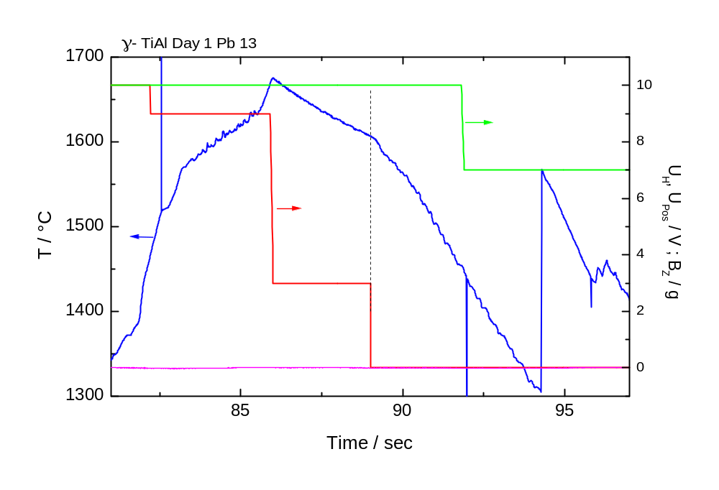
Processing in parabolic flight for surface tension
and viscosity measurement
TiAlNb Tliq = 1570 °C

Slide 26
Motivation:
High temperature – high chemical reactivity of many industrial metallic liquids.
⇒ Lack of reliable thermophysical property values
needed for casting & solidification modelling.
Approach:
Containerless processing with emphasis on short
and long duration microgravity experiments.
Supported by a ground based experimental programme.

Slide 27
Procedere
• need as precise modelling as possible
⇒ Parabolic flight Nov. 2007
ground based test experiments with Ni-68.5at%Al
and with Ni-50at%Al
• Coupling tests with Fe, Ti, Zr
Cross calibration PF-eml and TEXUS-eml
Calibration experiments with cameras – 50 Hz telecentric

Slide 28
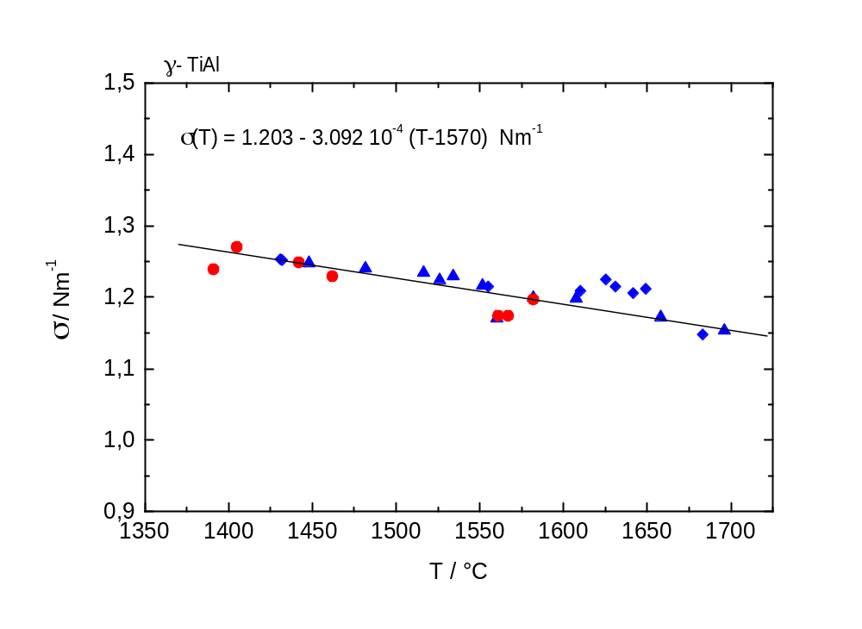
TEXUS sounding rocket suface tension of TiAlNb
TEXUS
PF
σ (T) = (1.232 ± 0.030) – ( 4.38 ± 0.20 ) 10⁻⁴ ( T − 1842 K ) Nm⁻¹
σ (T) = ( 1.195 ± 0.012) – (4.23 ± 0.22 ) 10⁻⁴ ( T − 1842 K ) Nm⁻¹

Slide 29
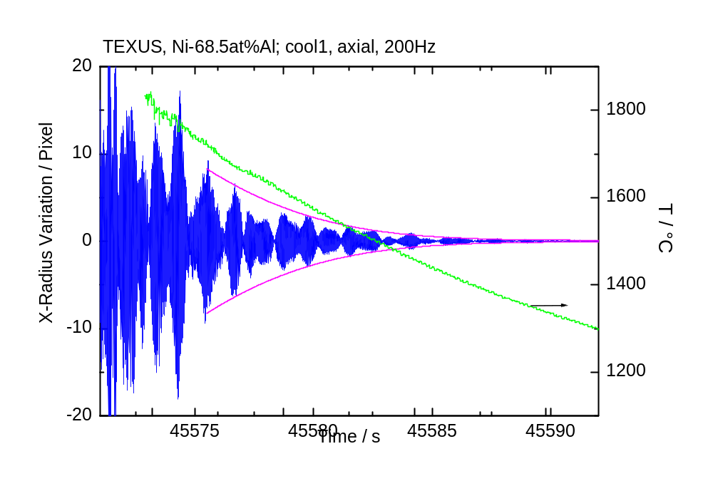
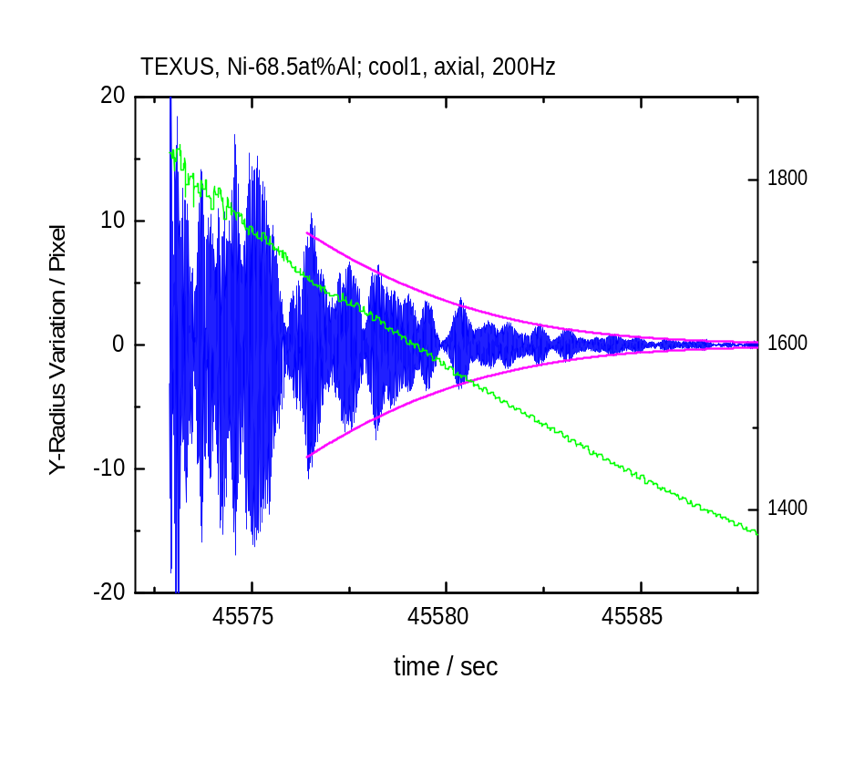
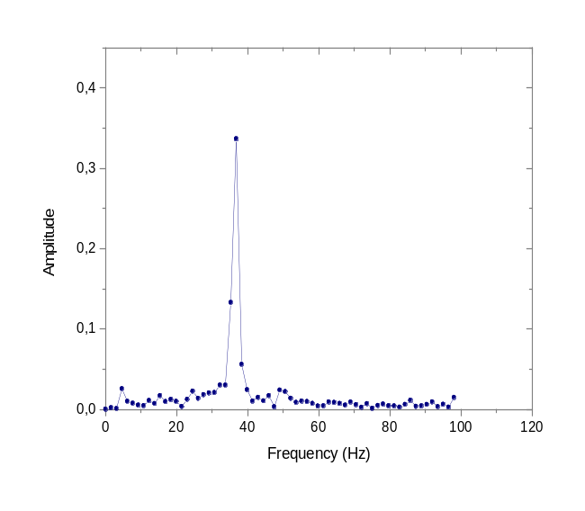
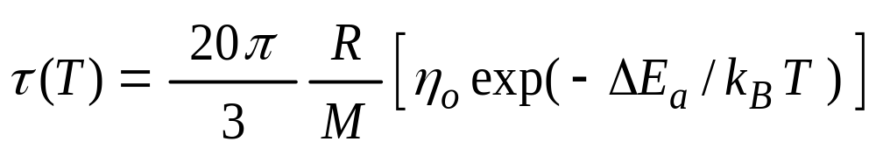
Different measures of sample shape deformations
Fit of envelope with:

Slide 30
Long and Intermediate Duration Microgravity Platforms
• Past: Spacelab
• Future: International Space Station - ISS
Present: TEXUS sounding roket - max. 340 sec of μ-g
Methods for thermophysical property measurements with EML:
Non-contact ac-calorimetry for c_{P} - measurements
Surface tension and viscosity by the oscillating drop method
El-resistivity by mutual inductance between specimen and
heating coil (DLR-Cologne)
Solidification velocities, growth kinetics (DLR-Cologne)
Density (DLR-Cologne)

Slide 31
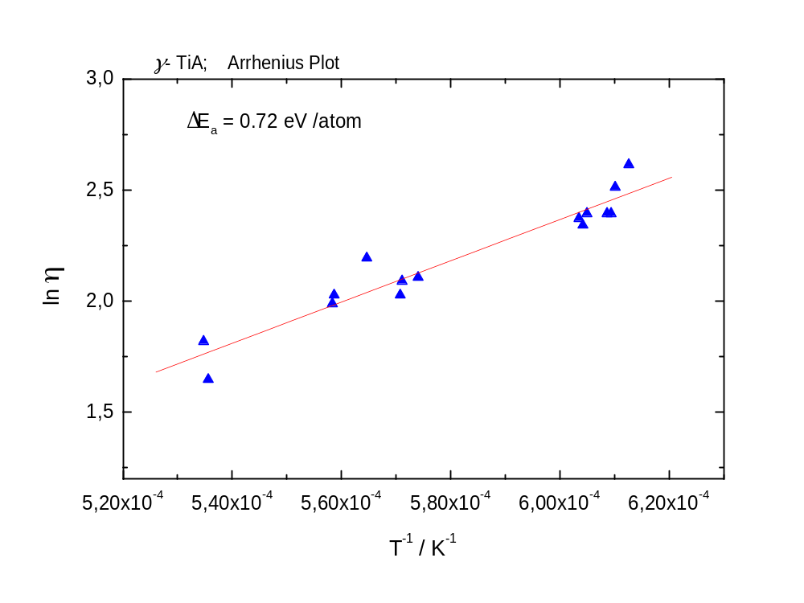
Viscosity of γ – TiAl as a function of temperature
η = η_{o} exp ( ΔE_{a} / k_{B} T )
ΔE_{a} | 0.72 eV/atom
η_{o} | 0.041 mPa.s
T_{liq} = 1572 °C

Slide 32
Results from TEXUS - eml for γ -TiAl
specific heat capacity in the liquid phase at
three temperatures
• total hemispherical emissivity
thermal expansion
verification of PF-flight results for surface
tension and viscosity
•

Slide 33
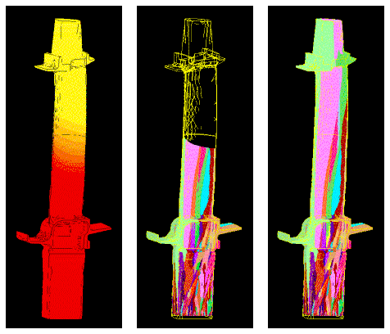
Objectives:
Measurement of thermophysical properties of industrial alloys
in the liquid phase for application in liquid metal processing and solidification modelling.
viscosity
surface tension
specific heat capacity
density
enthalpy of fusion
fraction solid
thermal conductivity
thermal diffusivity
el. resistivity

Slide 34
Alloys Processed on Parabolic Flights within ThermoLab
Partner Alloy Source
Ladish Ti64, Ti6242 Oct. 2001
TIMET Ti64 Oct. 2002
MTU γ -TiAl, C263, Rene N 5 Juni 2003, Nov. 2006
Doncasters CMSX-4 Oct. 2002
ALSTOM IN738LC, MM247LC Juni 2003, Nov. 2006
CORUS low alloyed steel Juni 2003, 2004
DaimlerChrysler Grauguß, GGV Juni 2003
SANDVIK Steel Sept. 2004
Wieland Metallwerke Cu-Alloys Sept. 2004, Nov. 2006
Generic Ni – Al Sept 2004, 2005, Nov. 2006

